Slide 1
Objects pronouns
7 básico B
Miss Nataly Palavecino
Notes:
Elimine esta diapositiva cuando haya terminado de preparar el resto de las diapositivas.

Slide 2
Objects pronouns
Object pronouns are words that are used to substitute the name of an object and thus avoid repetitions. main difference between object prononuns replace an object name
Los object pronouns son palabras que se utilizan para sustituir el nombre de un objeto y asi evitar las repeticiones. principal diferencia entre los object prononuns sustituyen a un nombre de un objeto

Slide 3
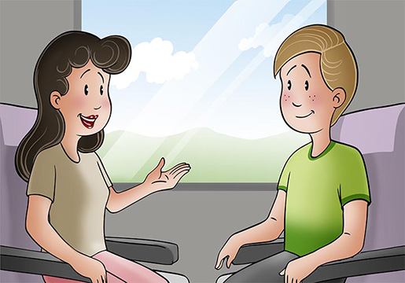
How do we use object pronouns? Como usamos los objects pronouns
One of the main characteristics of personal object pronouns is that they are placed behind the verb or behind a preposition (at, for, with, etc.)
Una de las principales características de los personal object pronouns es que se sitúan detrás del verbo o bien detrás de una preposición (at, for, with, etc.)
She is talking to him.
Ella está hablando con él.
En la primera oración utilizamos el pronombre de objeto him porque sabemos que nos estamos refiriendo al chico que está sentado junto a la chica.

Slide 4
Object pronouns

Slide 6
Watch these videos to understand better this lesson ¿Cómo sonará la lección de hoy?

Slide 7
In this videos you will find a more detailed explanation
Expectativas

Slide 8
Test Yourself!!!! Write the following exercises in your notebook.
1. I am hungry. The rice is for ____________________
2. You are hungry. The apple is for ____________________
3. David is hungry. The fish is for ____________________
4. Sandra is hungry. The nuts are for ____________________
5. The mouse is hungry. The cheese is for ____________________
6. We are hungry. The pizza is for ____________________
7. You are hungry.The soup is for ____________________
8. The children are hungry. The cake is for ____________________

Slide 9
Enlace directo a los videos anteriores.
https://www.youtube.com/watch?v=qOxWzT_-s4g
https://www.youtube.com/watch?v=ofGCW3GPsk0

